Slide 1

Learning Agent for Personalized Education System
Design brief: an AI-driven learning agent that personalizes instruction, improves over time with feedback, adapts difficulty, and integrates with distributed data systems like PySpark. Visual roadmap across architecture, feedback loops, adaptation strategies, and scalable analytics.
Presented by
Bodham sushma (192571065)
Mithra Devi (192524203)

Slide 2
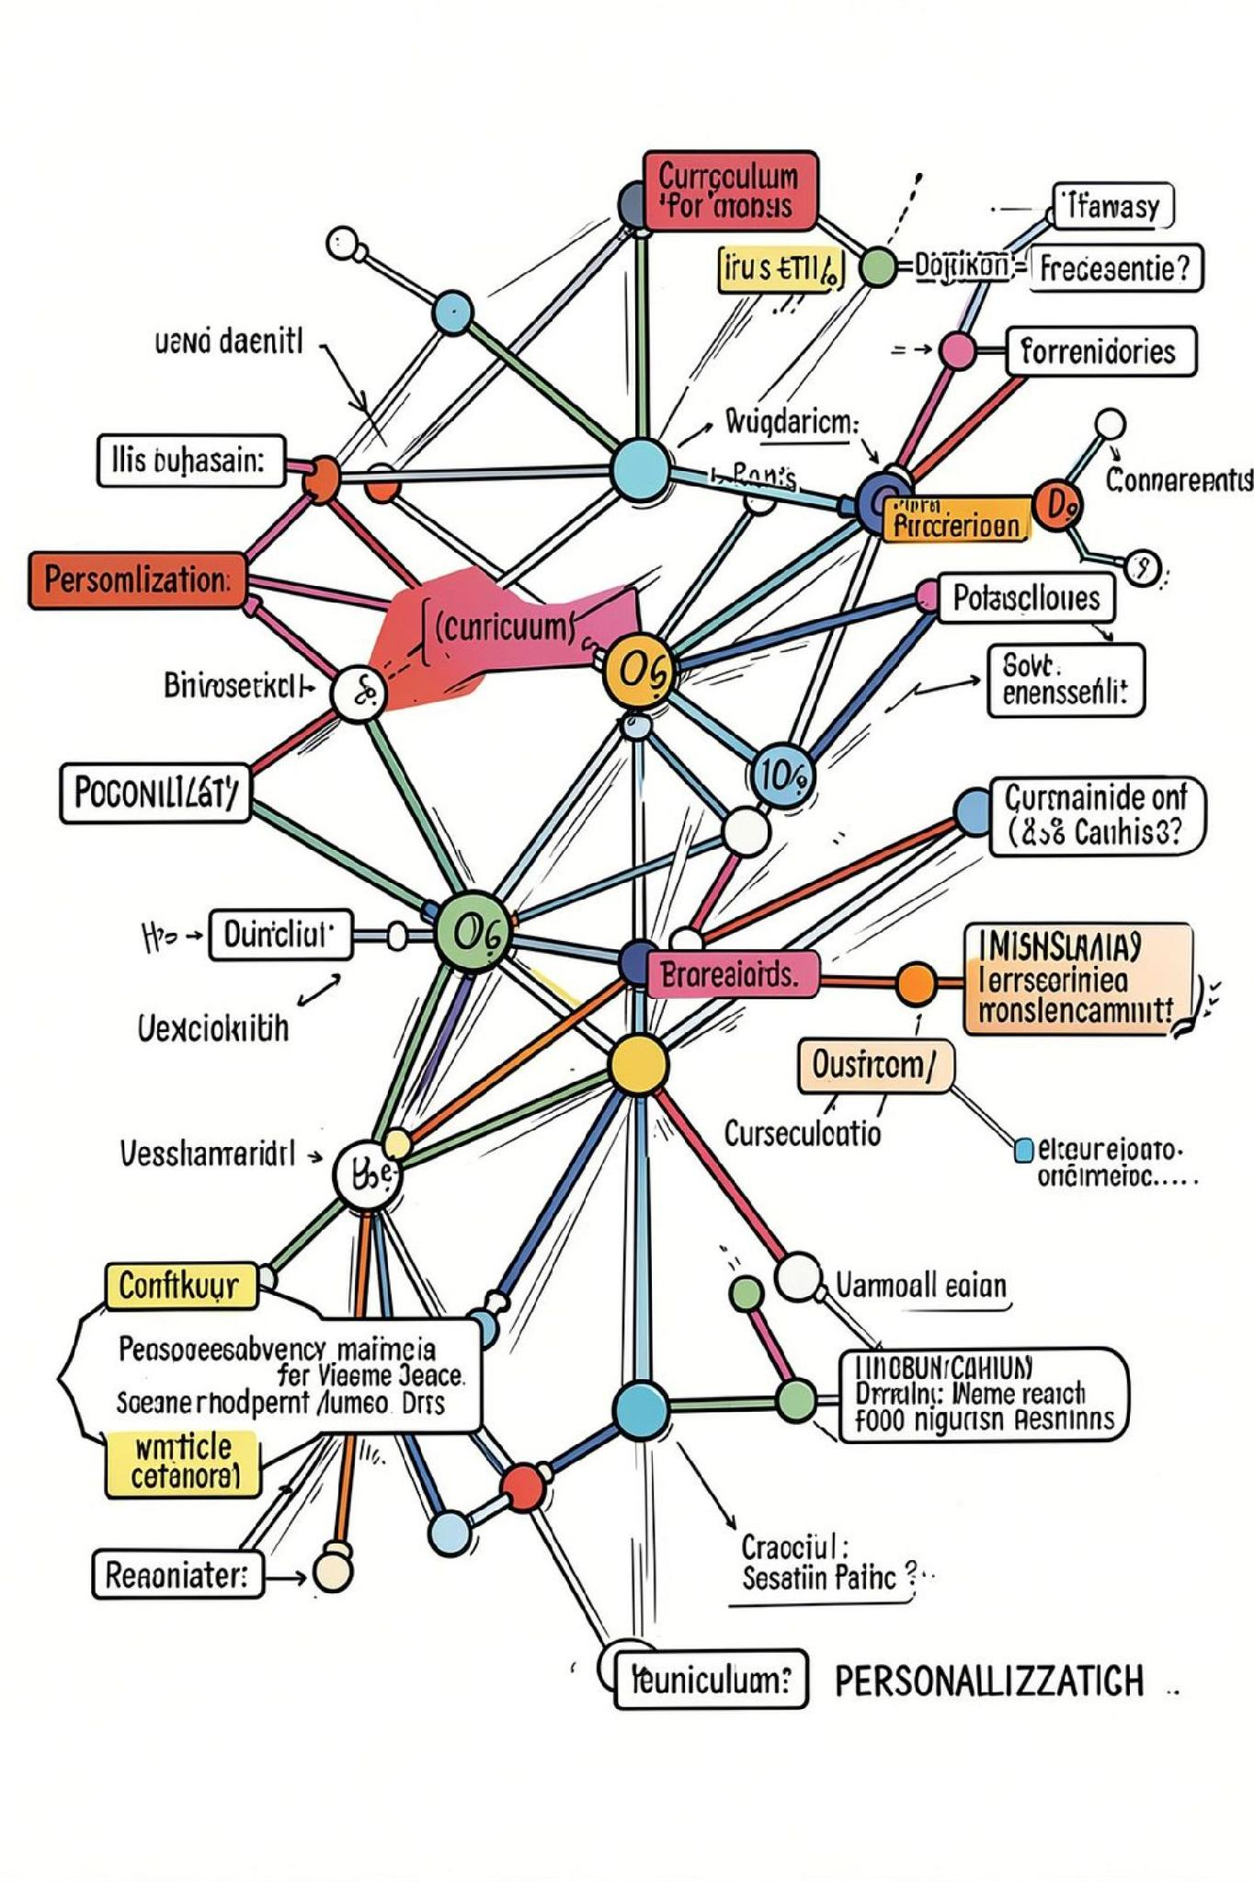
The Goal: Personalize Beyond Recommendations
Move past static recommendations to continuous curriculum adaptation, real-time tutoring, and long-term pathway shaping. Deliver proactive interventions that evolve across sessions and learning phases while preserving pedagogical safety.

Slide 3
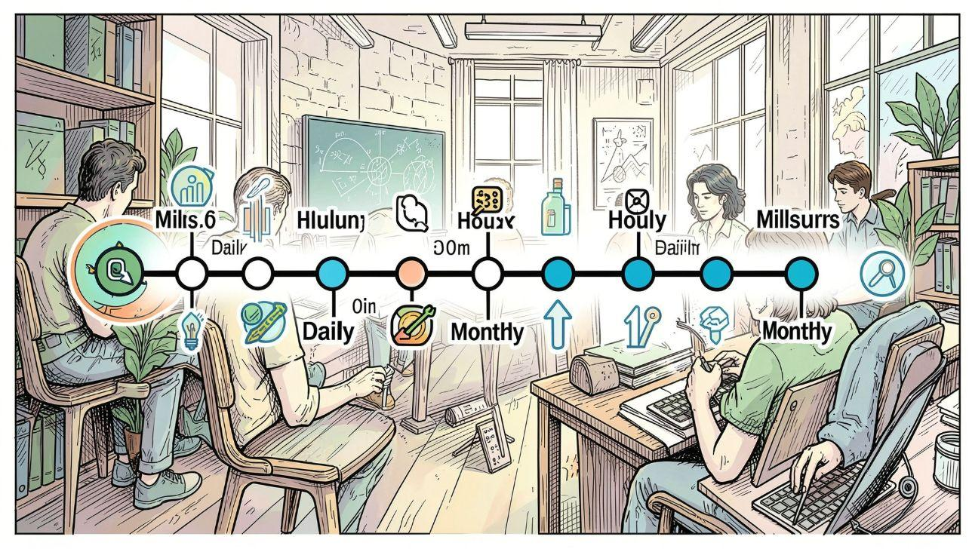
Slide-to-Student Loop: Feedback at Multiple Temporal Scales
Temporal stratification
Milliseconds: immediate hints, scaffolding during problem solving
Hours–Days: sequencing, targeted practice and spaced repetition
Months: mastery milestones, career and curriculum shifts
A QA meta-layer validates pedagogical soundness, factual accuracy, and consistency before outputs reach learners.

Slide 4
How Performance Improves Over Time
Continuous Perception
Periodic Strategic Updates
Micro-interventions
Perception agents log interaction signals (responses, latency, hints requested) and update the shared learner model in real time.
Strategic agents retrain trajectories and engagement models using aggregated time-series to forecast dropout risk and mastery curves.
When progress stalls, the system triggers brief, targeted micro-lessons and re-evaluates competence to restore flow.

Slide 5

Adapting Content Difficulty — Not Just Easier or Harder
Coordination agents tune response complexity (explanations, worked examples, problem scaffolds) based on cumulative learner state and recent feedback. Difficulty shifts are routed, aggregated, and validated to avoid abrupt regressions or gaps.

Slide 6
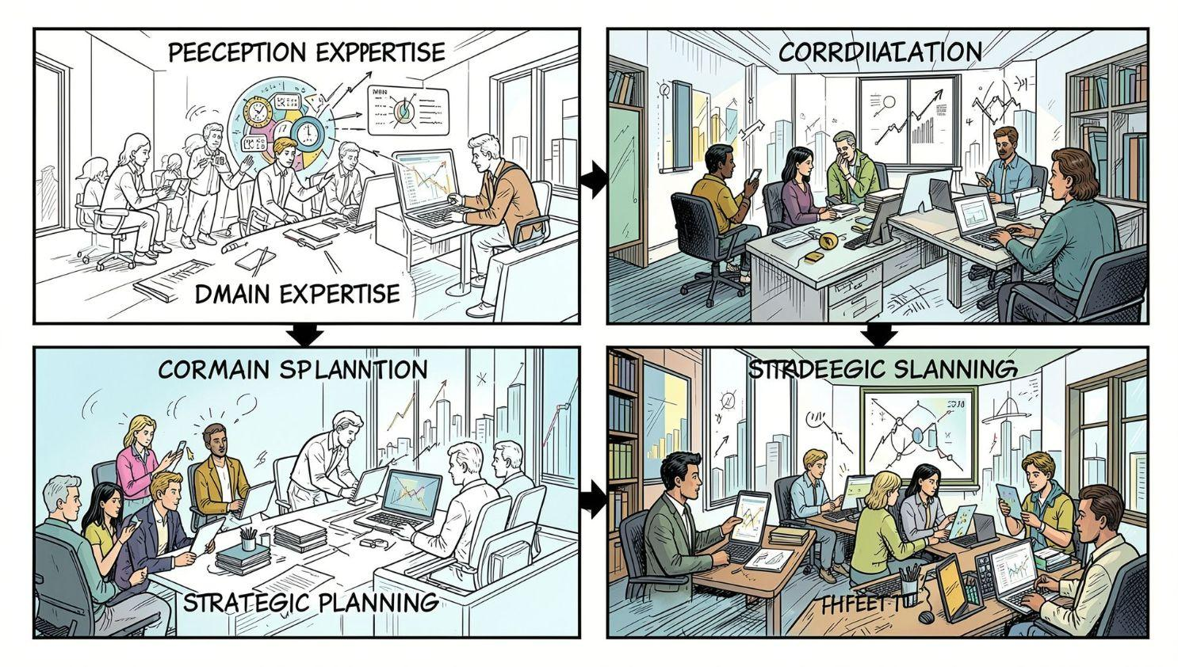

Multi-Agent Orchestration: Who Does What
Example routing: a systems question is sent to Code Analysis + System Design agents, then merged and QA-reviewed before delivery.
1
2
Perception
Domain Expertise
Logs fine-grained signals: correctness, hint frequency, time-on-step.
Content generation, code analysis, worked solutions, semantic feedback.
3
4
Coordination
Strategic Planning
Routers, difficulty scalers, and ensemble synthesis for responses.
Long-term personalization, curriculum sequencing, and policy updates.

Slide 7
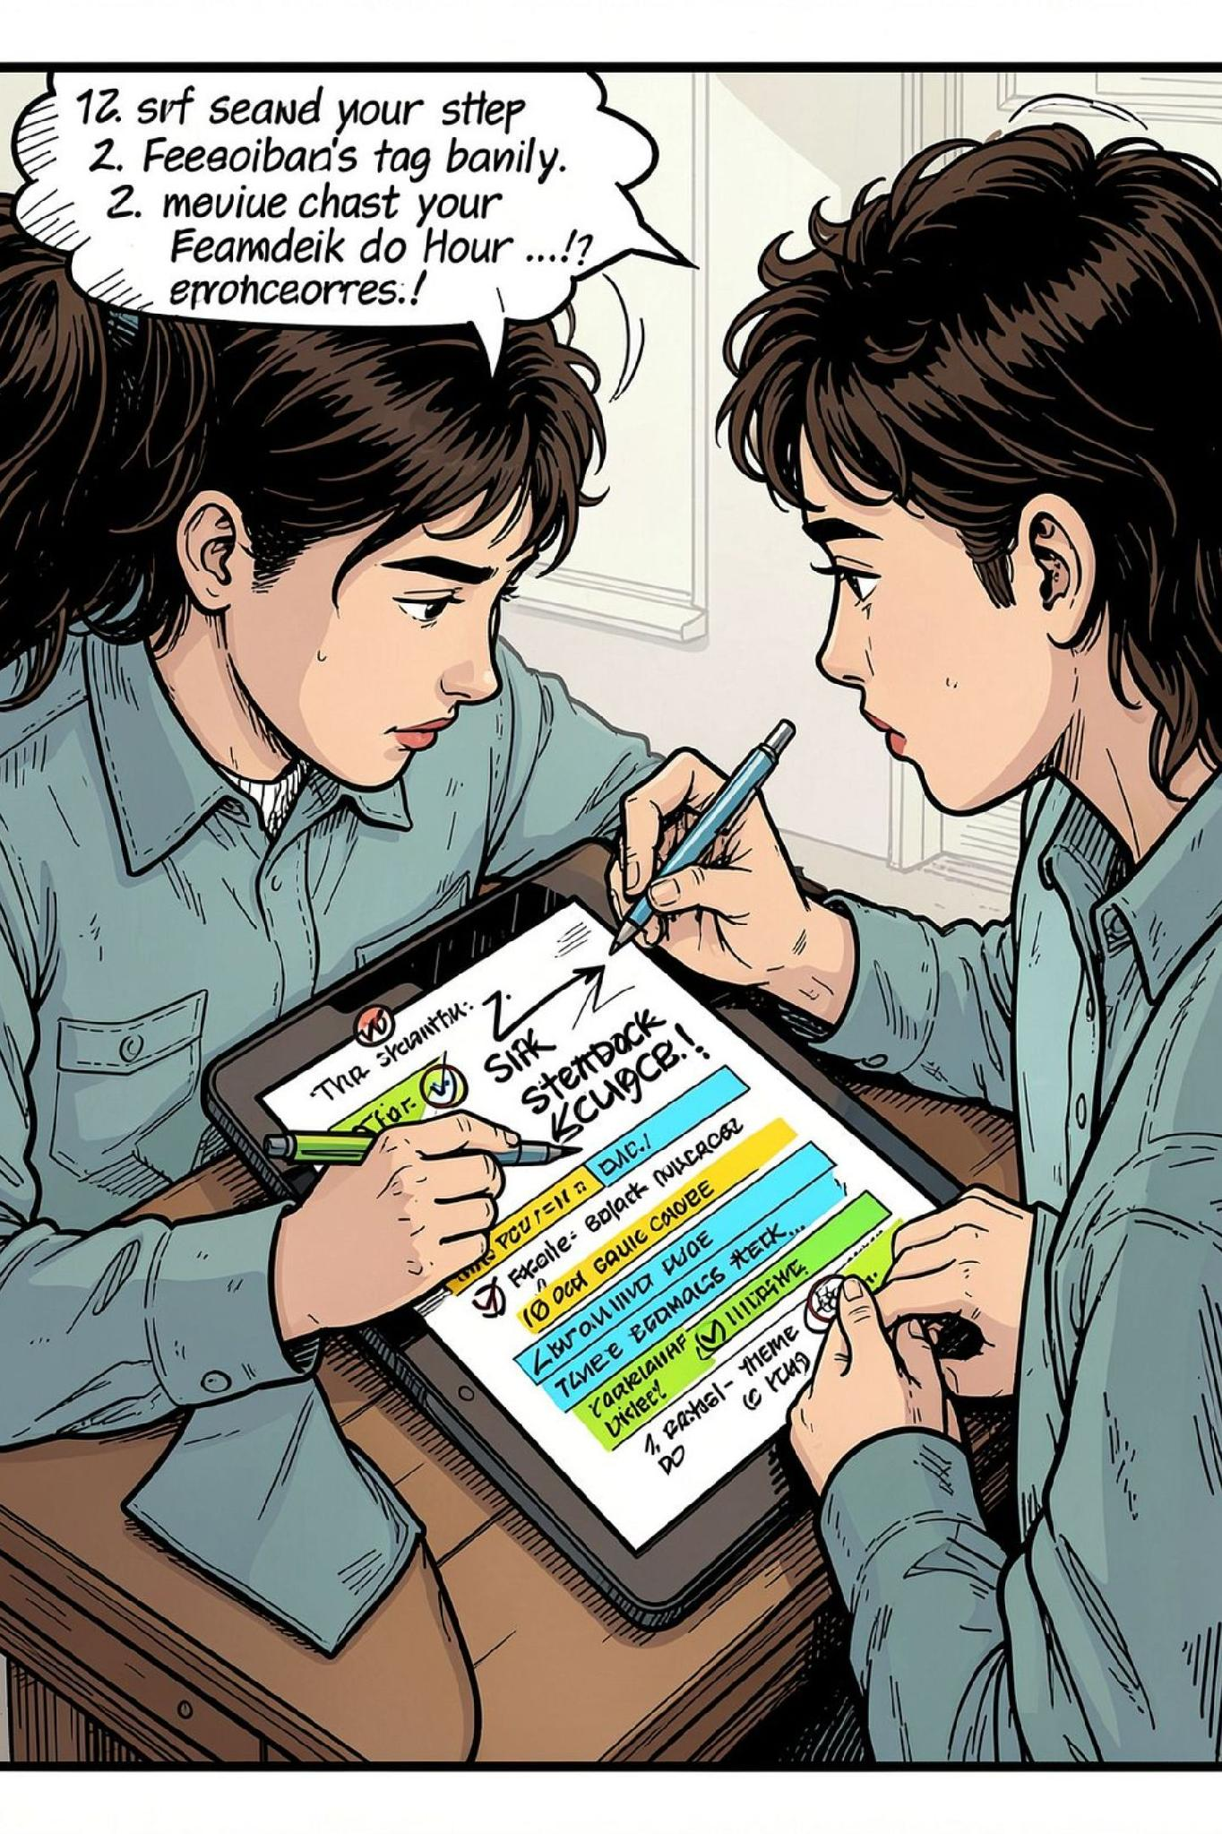
Feedback That Teaches: Immediate, Corrective, Actionable
01
02
Acknowledge
Evaluate
Recognize attempted strategy to reinforce effort and reduce defensiveness.
Provide concise, criterion-based assessment tied to explicit objectives.
03
Correct & Scaffold
Offer targeted repairs: example comparisons, guided prompts, next-step practice.

Slide 8

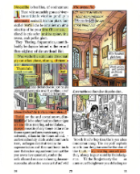

Curating Learning Materials: Agent-Driven Delivery (ILMDA)
Case-based Reasoning
ML + Fuzzy Logic
Simulation evidence: after targeted phases, average problem scores rose notably (system logs: pre-phase 0.407 → post-phase 0.568). ILMDA personalizes content sequencing and format (video, worked example, interactive).
Match new tasks to previously effective exemplars for similar learner profiles.
Blend probabilistic predictions with soft rules to pick materials that fit uncertainty in learner state.
Combine algorithmic curation with human-curated checks for domain sensitivity and alignment.

Slide 9

Distributed Data Integration with PySpark (Scalable Learning Ops)
Write learner artifacts (skill graphs, error taxonomies, engagement time series) to a learner-model store.
Use PySpark for distributed feature engineering over large logs: session attempts, dwell time, hint patterns.
Aggregate temporal signals to produce refreshed features that strategic agents consume on schedule (daily/weekly).
Design tip: keep transform logic idempotent, version feature schema, and enable stream + batch hybrid processing for low-latency updates.

Slide 10

Conclusion — A System That Improves With Every Interaction
Parallel, Specialized Agents
Temporal Stratification
Scalable Analytics
Delivers both immediate tutoring and long-term trajectory management.
PySpark-powered pipelines make large-scale feature engineering and model refresh practical.
Enable domain-level rigor and faster iteration than monolithic models.
Final outcome: safer, continuously improving tutoring at scale—augmenting human instructors with data-driven personalization while preserving human oversight.

